Slide 1
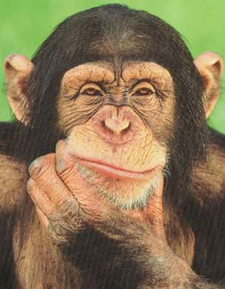
Décisions
Notes:
Slides 1-7 revise the 9 animals. Slide 8 begins the new learning – how to create the plural form in French. Decisions. In this activity pupils must choose between two animal options to identify the correct animal asked for in the question.

Slide 2
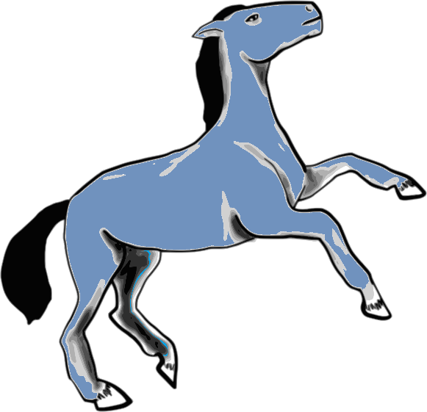
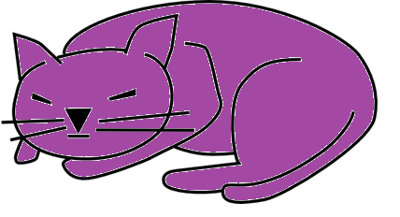
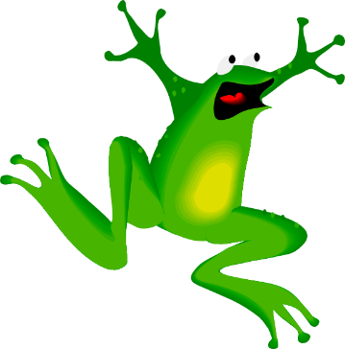
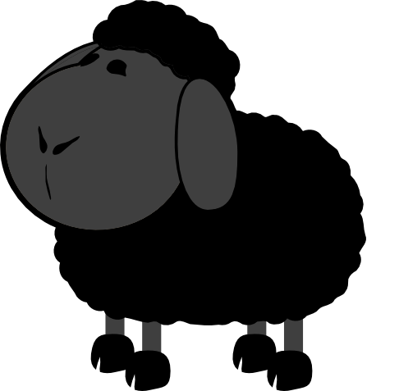
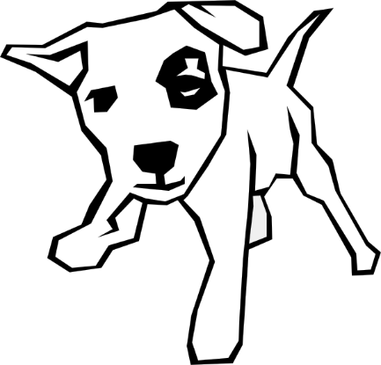
Qu’est-ce que c’est ?
Notes:
Point to animals to revise

Slide 3
Que vois – tu ?
Je vois …
Notes:
¿Qu’est ce-que tu vois? = What do you see? Je vois= I see … Animals will fly onto the screen and off again on your click. Pupils must say what the animal was. They should use ‘Je vois…’ to answer.

Slide 4
Lequel de ces 9 animaux est ton animal favori ?
Mon animal favori est …
Notes:
Lequel de ces 9 animaux est ton animal favori ?
= Which of the 9 animals is your favourite? Mon animal favori est …
…= My favourite animal is … Pupils choose which is their favourite and volunteer a sentence using the prompt provided. Click on the animal in question to check answer.

Slide 5
Qu’est-ce qui manque?
Notes:
Pupils will see all 9 animals on the next screen, then, on your click, one will have disappeared. Pupils must volunteer which animal was the latest to disappear.

Slide 6
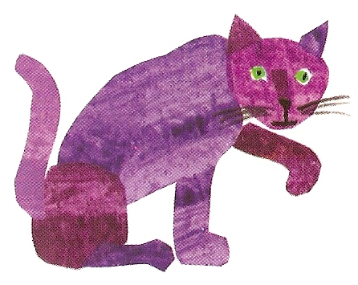
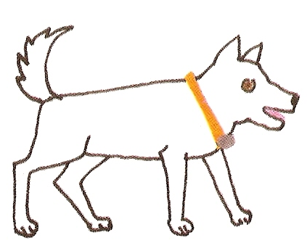
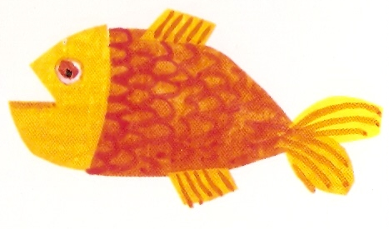
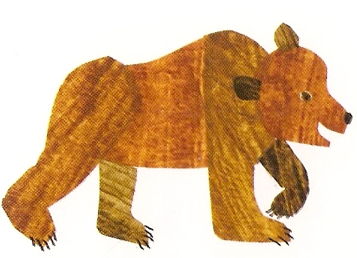
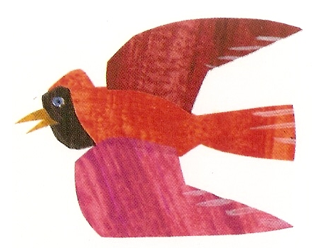
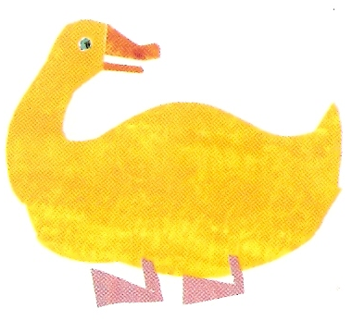
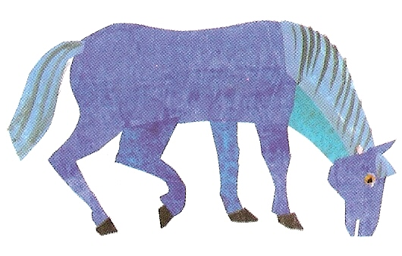
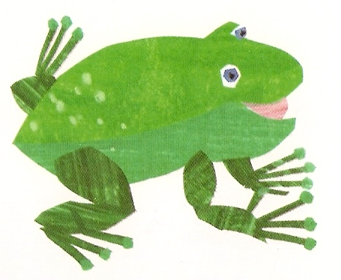
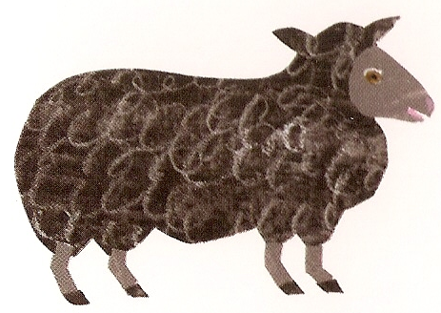
Qu’est-ce qui manque?
Notes:
Qu’est-ce qui manque?
= What’s missing? Click on the question to hear it pronounced.

Slide 7
Je suis allé à l’animalerie et j’ai acheté…
Notes:
Je suis allé à l’animalerie et j’ai acheté…
…= I went to the pet shop and I bought …. Pupils have to play this game building up the list of animals they bought as the animals appear. Click on the latest animal to hear the list so far. Pupils should say the French prompt as well.

Slide 8
Nous allons apprendre …
les pluriels des animaux
Notes:
Nous allons apprendres les pluriels des animaux = We are going to learn the plurals of the animals. Pupils will learn how to form the plurals of nouns, 9 animals in this case. They are introduced with the number 2 (‘deux’) in front of them to avoid any distraction from digesting the main rule of plural forming (adding an ‘s’).

Slide 9
un chat
Notes:
As a revision, pupils are presented with the same pictures they learnt the main animal vocabulary with.

Slide 10
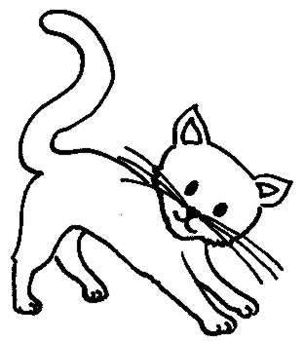
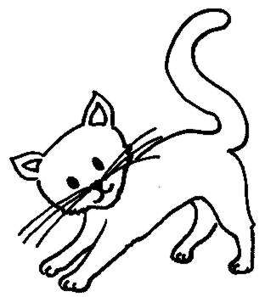
deux chats
Notes:
Then pupils see the plural form of each noun, presented as ‘two …s’. Pupils will quickly realise that the rule is similar to the rule for forming plurals in English, although even more straightforward, which is to add an –s. I’ve presented the plural form on a green/blue background to show that even though the noun is now plural, green, it still retains the masculine gender, blue.

Slide 11
un chien
Notes:
Instructions as per slides 2&3.

Slide 12
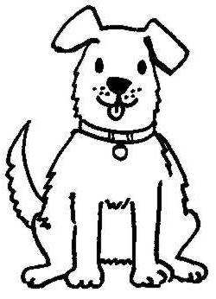
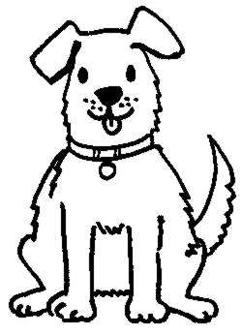
deux chiens
Notes:
Instructions as per slides 2&3.

Slide 13
un poisson
Notes:
Instructions as per slides 2&3.

Slide 14
deux poissons
Notes:
Instructions as per slides 2&3.

Slide 15
un canard
Notes:
Instructions as per slides 2&3.

Slide 16
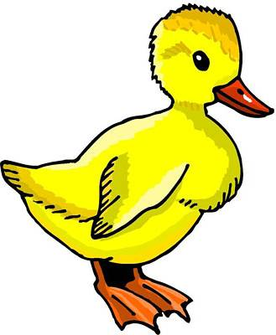
deux canards
Notes:
Instructions as per slides 2&3.

Slide 17
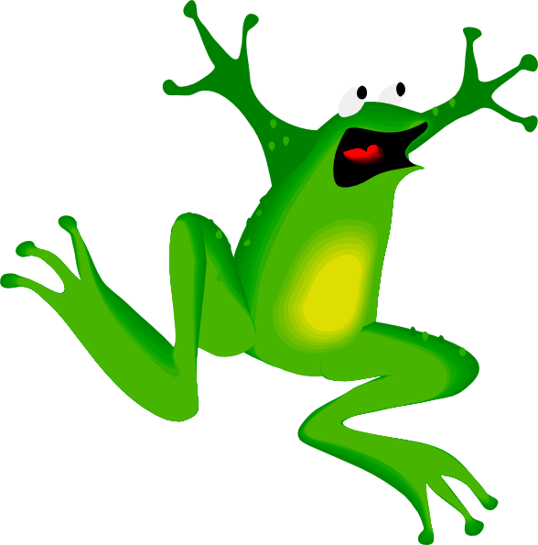
une grenouille
Notes:
Instructions as per slides 2&3.

Slide 18
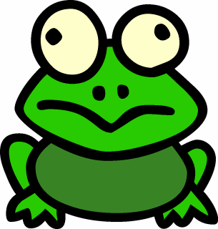
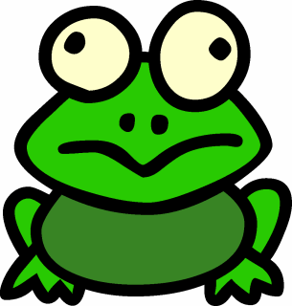
deux grenouilles
Notes:
I’ve presented the plural form on a green/red background to show that even though the noun is now plural, green, it still retains the feminine gender, red.

Slide 19
un ours
Notes:
Instructions as per slides 2&3. These are the three exceptions within this group of 9 nouns. NB: Where there is already an –s on the singular noun, usually the plural remains the same as the singular

Slide 20
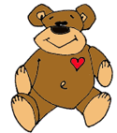
deux ours
Notes:
Instructions as per slides 2&3. These are the three exceptions within this group of 9 nouns. NB: Where there is already an –s on the singular noun, usually the plural remains the same as the singular

Slide 21
un oiseau
Notes:
Instructions as per slides 2&3.

Slide 22
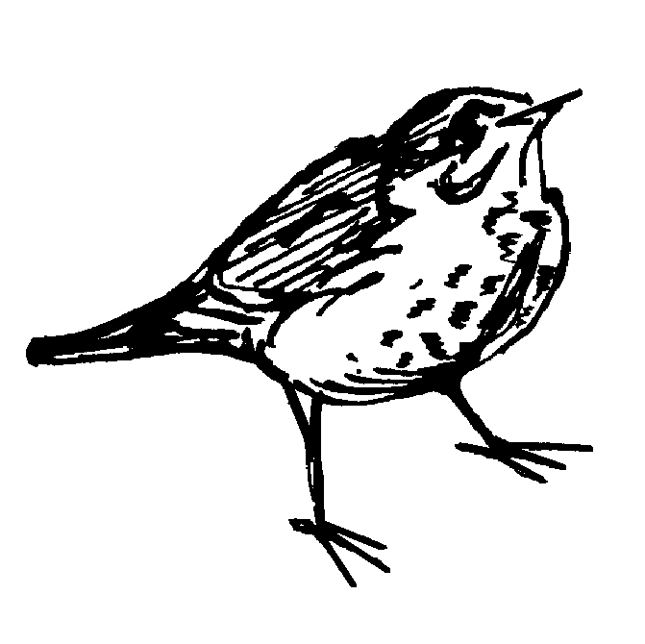
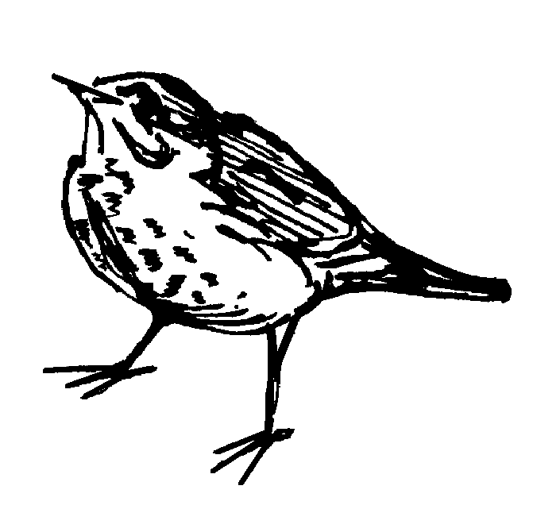
deux oiseaux
Notes:
Instructions as per slides 2&3.
The plural of –eau nouns is -eaux

Slide 23
un cheval
Notes:
Instructions as per slides 2&3.

Slide 24
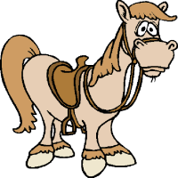
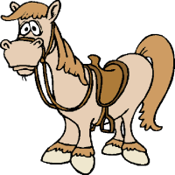
deux chevaux
Notes:
Instructions as per slides 2&3.
Note that this is also an irregular plural.

Slide 25
Que sont – ils ?
Ce sont deux chats.
Notes:
Que sont – ils ?= What are they? Encourage pupils to use the verb ‘Ce sont…’ to begin their answer – getting them familiar with commonly-used vocabulary & phrases which will be invaluable to them in the future. Click to reveal plural animals & click again to see a written answer.

Slide 26
Que sont-elles ?
Ce sont deux grenouilles.

Slide 27
Que sont –ils ?
Ce sont deux canards.

Slide 28
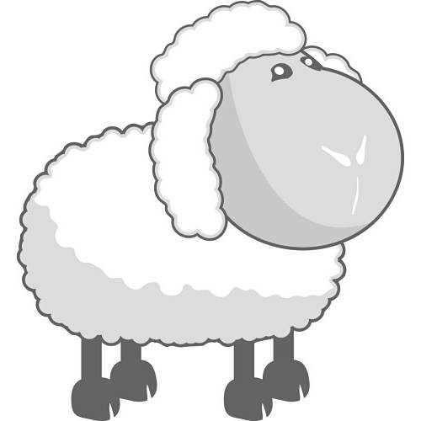
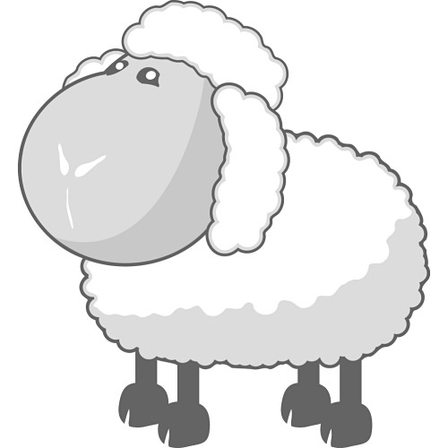
Que sont-ils ?
Ce sont deux moutons.

Slide 29
Que sont-ils ?
Ce sont deux chiens.

Slide 30
Que sont-ils?
Ce sont deux ours.

Slide 31
Que sont-ils ?
Ce sont deux chevaux.

Slide 32
Que sont les pluriels?
pont
éléphant
banane
lapin
stylo
question
crayon
fête
idée
enfant
ponts
éléphants
bananes
lapins
stylos
questions
crayons
fêtes
idées
enfants
Notes:
An exercise to apply the new plural rule to other nouns pupils already know (from key phonics in the Autumn Term). It’s important that students notice that in French we usually don’t pronounce the ‘s’ in the plural!

